Slide 1

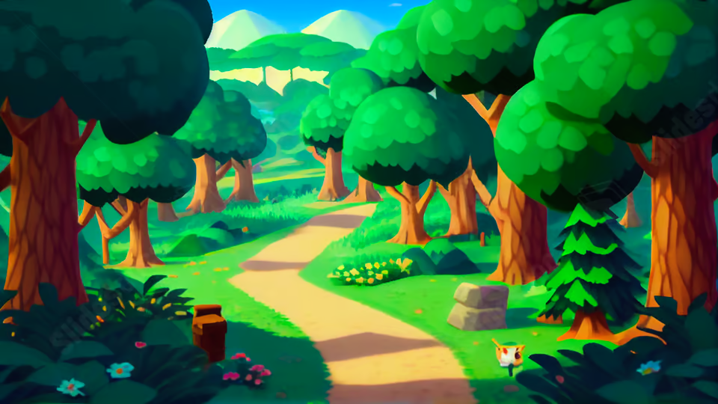




Are you ready
for class?

